Slide 1
Methodist Miracle
© 2016 Rick Richardson

Slide 2
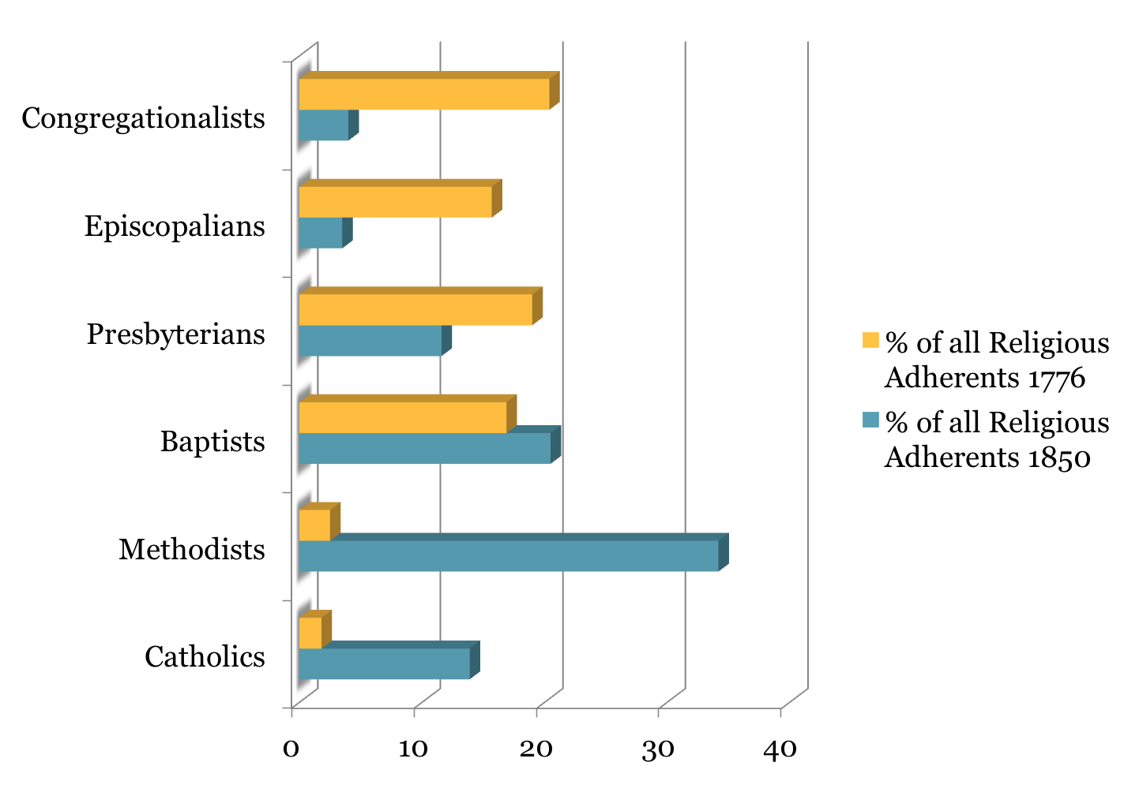
© 2016 Rick Richardson

Slide 3
Methodist Miracle
Methodists went from a tiny religious society of 65 churches scattered through the colonies to 13,302 congregations enrolling more than 2.6 million members by 1850, towering over all the other denominations.
© 2016 Rick Richardson

Slide 4
Methodist Miracle
this was during the time in which Lyman beecher (Congregationalist) and later Sydney Ahlstrom would say that America reached the lowest religious ebb tide in her history in the 20 years after the revolutionary war, prior to the great awakening.
© 2016 Rick Richardson

Slide 5
Methodist Miracle
BEECHER FELT JUSTIFIED IN SAYING AN AREA WAS RELIGIOUSLY DESTITUTE AS LONG AS IT WAS WITHOUT EDUCATED MAINLINE CLERGY; METHODIST AND BAPTIST CHURCHES WERE “WORSE THAN NOTHING.”
© 2016 Rick Richardson

Slide 6
Methodist Miracle
Organizational structures: Class and lay leadership
Ministers: of the common people
Message: conversion, challenge
Routine revival: Sanctification
Camp meetings: ecstasy
Reaching slave and free
Courage in the face of persecution
© 2016 Rick Richardson

Slide 7
Baptists and Methodists Switch
© 2016 Rick Richardson

Slide 8
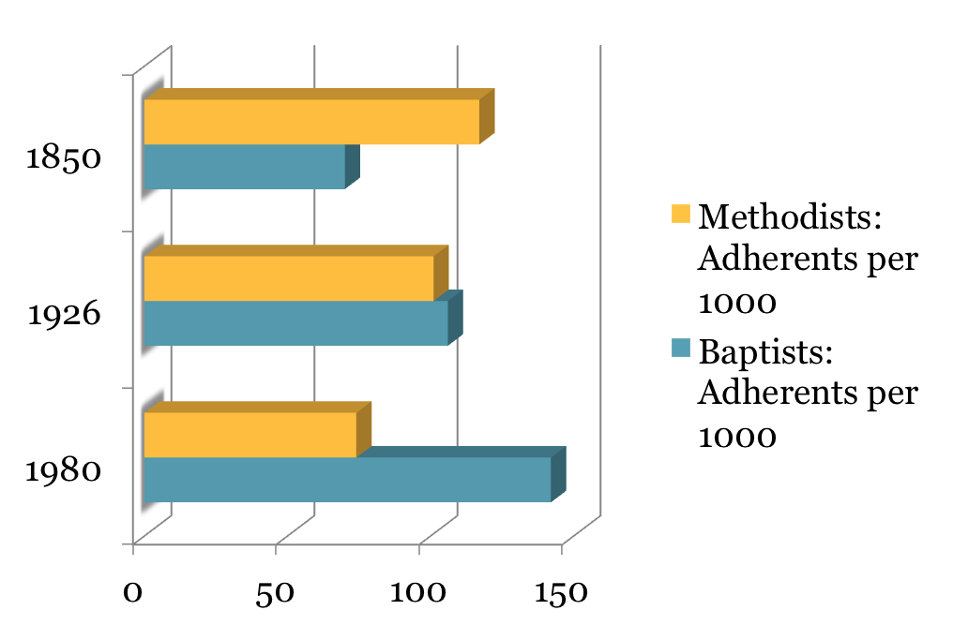
© 2016 Rick Richardson

Slide 9
Baptists and Methodists Switch
Methodists became middle class
Circuit riders dismounted
Democracy waned (lay leadership declined)
Clergy became seminary trained
Methodists adopted upscale practices
Many of the most enthusiastic methodists started new sects
© 2016 Rick Richardson

Slide 10
Baptists and Methodists Switch
The main point: the churching of America was accomplished by aggressive churches committed to vivid otherworldliness
Winners and losers in the religious economy follow this pattern.
© 2016 Rick Richardson

Slide 11
Baptists and Methodists Switch
THEIR THESIS IS THAT SUCCESSFUL SECTARIAN MOVEMENTS DEVELOP STRONG INTERNAL PRESSURES TO LOWER THEIR TENSION WITH THE SURROUNDING CULTURE. THESE PRESSURES COME FROM HAVING AN INCREASINGLY AFFLUENT MEMBERSHIP AND FROM AN INCREASINGLY “PROFESSIONALIZED” CLERGY.
© 2016 Rick Richardson

Slide 12
Baptists and Methodists Switch
TOGETHER, THE PRIVILEGED LAITY AND THE “WELL-TRAINED” CLERGY BEGIN TO LIFT RESTRICTIONS ON BEHAVIOR AND TO SOFTEN DOCTRINES THAT HAD SERVED TO SET THE SECT APART FROM ITS SOCIAL ENVIRONMENT-A PROCESS KNOWN AS SECT TRANSFORMATION OR SECULARIZATION.
© 2016 Rick Richardson

Slide 13
Long Term Health & Growth
Passionate Faith
Cultural Translation
Theo-Moral Integrity
© 2016 Rick Richardson

Slide 14
Long Term Health & Growth
Passionate Faith: (Benefits)
Cultural Translation (Bridges)
Theo-Moral Integrity (Boundaries)
© 2016 Rick Richardson

Slide 15
KEY QUESTIONS:
Where do you see your Church/denomination on the SECT TO CHURCH TRAJECTORY?
What is strong for you in relation to passionate faith, theo-Moral integrity and cultural translation?
Where do you most need to grow or recover in areas of passionate spirituality, theo-MORAL integrity or cultural translation?
What one thing do you think god may be saying in relation to your direction for your future as churches and as a denomination?
© 2016 Rick Richardson

